Slide 1
Call Volume Forecasting – South Star
Group 3
March 22, 2023

Slide 2
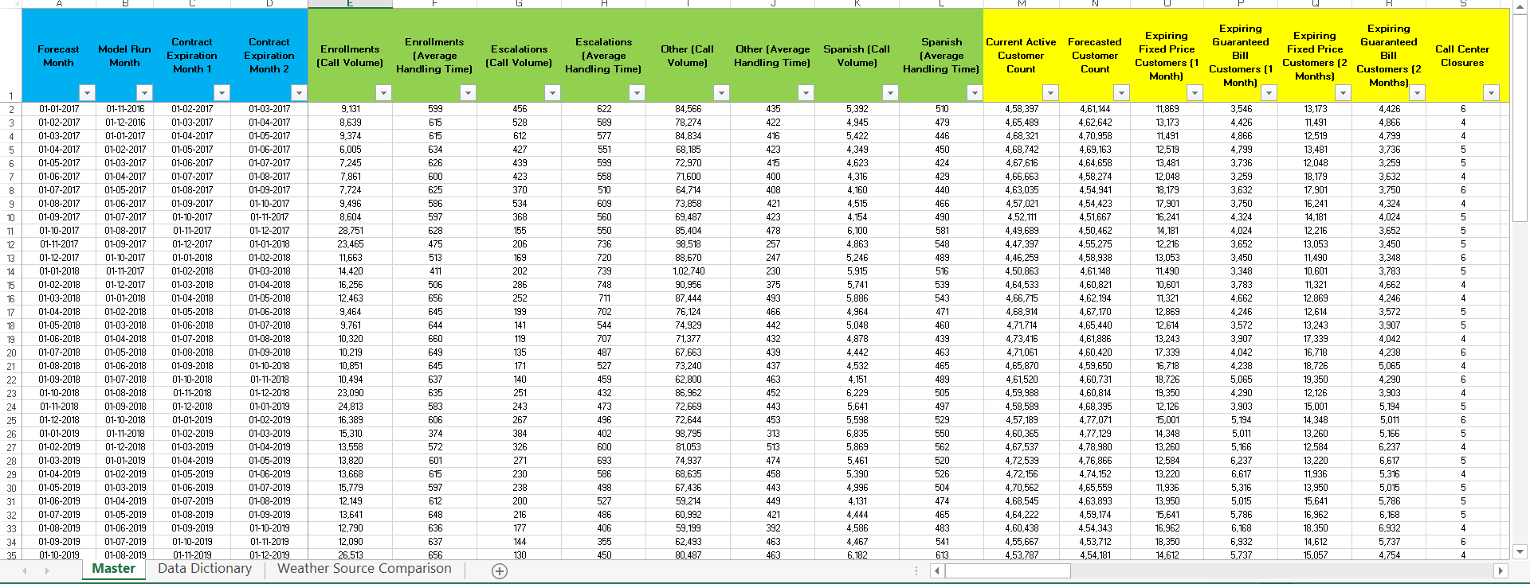
Dataset Info

Slide 3
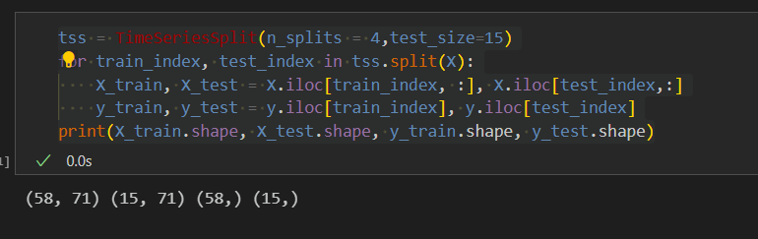
Data Pre-processing
One hot encoding
Time Series split
Train – 58 rows
Test – 15 rows

Slide 4
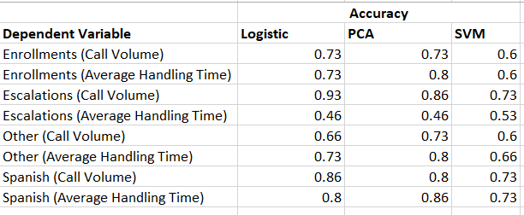
Data Modelling

